Slide 1
MyCar Dream Assignment
SUBMISSION
Name : Anand Sonawane
Roll Number :DDA1610282

Slide 2
Abstract
Aim is to create a Automated Process to predict the Mileage of the Car.
The Dataset provided collects information of different types of cars and their attributes across the world.
The Dataset contains about 3 multivalued discrete and 5 continuous attributes.

Slide 3
Goals
We are supposed to make a Predictive Model with the following constraints:
The model should contain less than 5 variables.
According to the business needs, set the VIF to 2.
The model should be highly predictive in nature i.e it should show 80% (R squared)accuracy.

Slide 4
Approach
The following are the main steps to solve the Case Study
Business Understanding.
Data Preparation.
Model Development.
Model Evaluation and Testing.
Model Acceptance and Rejection.

Slide 5
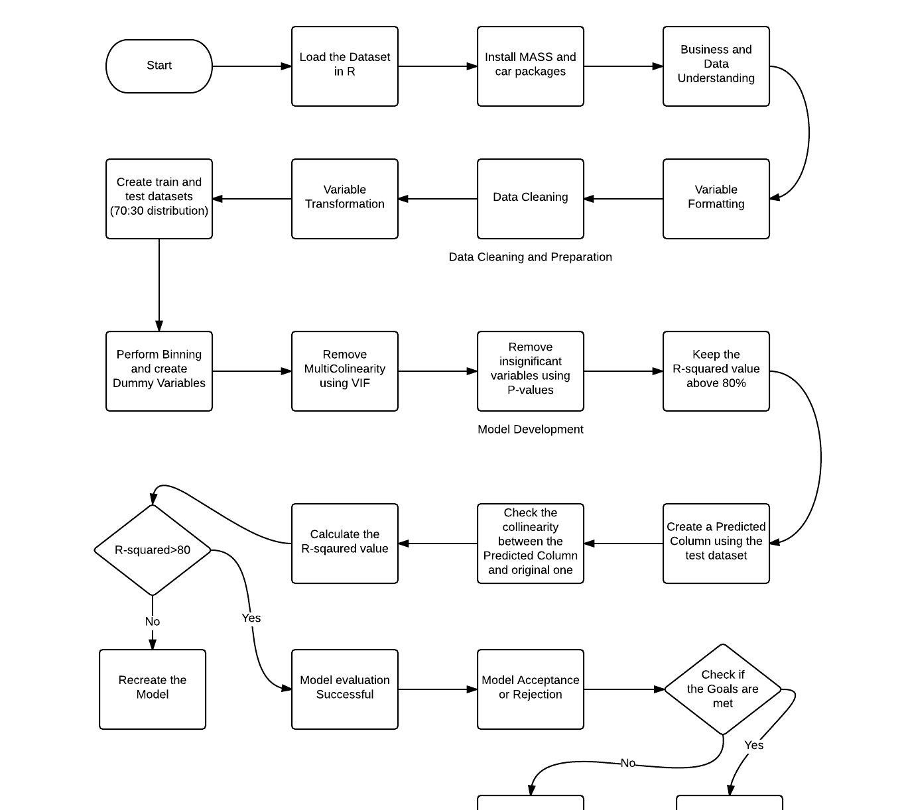
Flowchart(Included in the .zip)

Slide 6
Approach Part I
The approach for solving the Case Study is as follows:
The dummy variables which will be created are as follows:
No of Cylinders
Model Year of the Car (Binning is done for this)
Origin
Car_name means the Car Manufacturer.

Slide 7
Approach Part II
Binning for the Model Year is done as follows:
Considering each manufacturing year of the car is insignificant so we performed binning for the same.
The binning done is as follows:
Old (2003-2006)
Moderate (2007-2010)
New (2011-2015)

Slide 8
Approach Part III
For Predicting we are building a Model using Multiple Linear Regression.
The Approach to be followed is Step-wise approach to remove the extremely insignificant variables from the model.
The remaining variables are removed using VIF to remove variables based on multicollinearity and P-value to remove the insignificant variables.

Slide 9
Final Model
The final model is :
Contains 2 variables
Weight of the Car
The Model Year if the car is Old i.e made in the year 2003-2006
Has an high accuracy of 81.63%
All the variables are independent as they have a VIF value of less than 2.

Slide 10
Conclusion
The Final Model made is accepted as the R-squared value for the test dataset is 0.8366 indicating an accuracy of 83.66% .
The Final Model is just dependent on 2 variables making it clear for the user to understand what the Mileage of the car actually depends.

